Slide 1
Changing Beliefs
Finding and Removing Hidden Beliefs
to Allow Immediate Patient
Happiness and Health
Debra Basham & Joel P. Bowman, ICIM,
Lexington, Kentucky, March 2012
Notes:
One of the principal complaints about allopathic medicine is that it treats symptoms rather than problems. In some cases, that may be all a patient needs. In other cases, the problem is not the symptom but the underlying belief. It’s the difference between remedial change, correcting a specific problem, and generative change—setting a new direction.

Slide 2
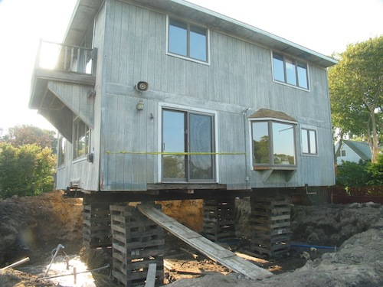
Values Are Foundational
Notes:
Values provide the underlying support for generative change. Most people see the world through a learned set of limitations. Generative change sets new directions by giving people a richer model of the world that allows for more options.

Slide 3
Values and Other Strong Beliefs Can Be Difficult to Change
“A MAN* WITH A CONVICTION is a hard man to change. Tell him you disagree and he turns away. Show him facts or figures, and he questions your sources. Appeal to logic and he fails to see your point.”
~Leon Festinger
*It applies to women, too.
Notes:
Festinger, a Stanford University professor of psychology, studied the influence of strong beliefs on behavior.

Slide 4
Quick Change Artistry
Use the “Magic But” to Initiate Change
I want to stop smoking, but I’m really addicted.
So, you’re addicted, but you really want to stop smoking.
I understand that I need to lose weight, but I don’t have time to exercise.
You don’t have time to exercise, but you understand that you need to lose weight.

Slide 5
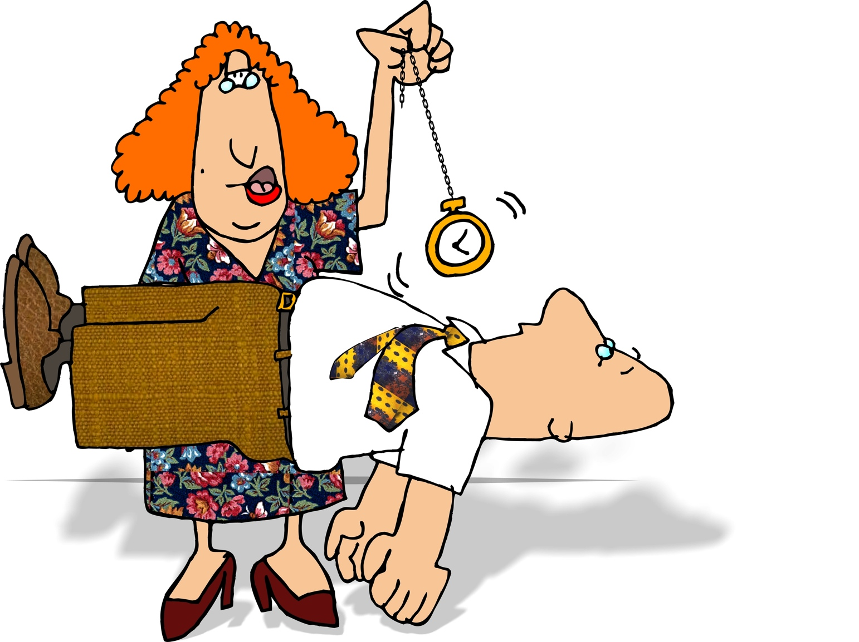
What If You’re a Hypnotist?

Slide 6
“Doctor Hypnosis”
Nocebos
White-coat syndrome
Eighty percent of those who have this disease die within 5 years.
Placebos
Make the “patient trance” work for you (and your patient)
Twenty percent of those who have this disease are alive and healthy even after 10 or 20 years.

Slide 7
Hypnotic Language
Presuppositions
How can you use what you learned from that experience now?
Do you agree or disagree that it is good that you are willing to make that change now?
Embedded Questions
I’m wondering how you know that.
I’m curious about whether you really mean that.
Embedded Commands
You can feel better in knowing that now.
When you want to know more, just ask.

Slide 8
More Hypnotic Language
Tag Questions (Voice Tone Down)
You’re feeling better now, aren’t you….
You’ve been taking your medication, haven’t you….
Conversational Postulates
Will you allow yourself to relax completely while I take your blood pressure?
Can you stick your tongue out for me now?
Metaphors
Just last week I had a patient who….
If you, like me, are interested in good health….

Slide 9
Hierarchy of Statements
Values
Beliefs
Strategies
Environment
Based on the theory of “Logical Levels” as developed by Robert Dilts, and its combination with the Metamodel of NLP as presented by Kathleen La Valle in an NLP workshop in Orlando, Florida, in July 2010.
Notes:
The language your patients use will indicate the structure of the problem. What is said is the linguistic surface structure. Underlying the surface structure is the linguistic deep structure. Underlying the deep structure is an experience.

Slide 10
Listen for Patterns
Language
The language your patients use tells you where to start to change problematic beliefs
Listen for patterns and metaphors
Start where (at the level) your patient is…
Values
Beliefs
Strategies
Environment
Move UP on the hierarchy, and then move back down to the environmental/behavioral level.

Slide 11
Values
Change for What Reason or Purpose?
Lasting change is determined by values
The top of the hierarchy influences what’s below
How will the Change Influence Who I am?
Closely held beliefs (core beliefs) determine identity
Closely held beliefs connect with values
Language Indicating Values
Nominalizations (Meanings Vary from Person to Person)
Freedom, Healing, Disease, Fear, Hope
Pharmaceuticals, High Blood Pressure
Notes:
Virginia Satir: When dealing with a self-styled righteous person I “recognize what he is telling me and find some kind of way to put into a context where he is going to be able to see something and also not feel isolated from me.”
This reminds me of inoculation in artwork sales: “You might be able to buy a product for less money, but if what you are investing in is pleasure, then the value of this product is clear.”

Slide 12
Bridges Between Values and Beliefs
Closely held—“core”—beliefs
Statements of identity: I am… You are… It is…
Universal quantifiers: I’ve always been sick…. I’ve never been sick….
Model of the World
Lost performative (It’s good/bad that you think that….)
Modal operators of necessity (Must, Have to, Can’t, Won’t)
Rules
I can’t do that / I must do that…
I should have known better…
Notes:
Virginia Satir: Definer statements: “This will hurt him.” “She will not like this.” “I know you/they/she/he_______.”

Slide 13
Beliefs
Statements of Cause and Effect
If X … then Y or X causes Y…
If I quit smoking, I won’t know what to do with my hands.
How do you know?
What do your nonsmoking friends do with theirs?
Presuppositions
I can’t see myself not smoking…
What would happen if you could?
I guess I’m just a die-hard smoker….
What do you mean?

Slide 14
Strategies into Beliefs
Metaphors
Last week I had a patient who…
I smokers often do die hard, and you have options.
Limiting and Irrational Beliefs
Mind reading
You’re thinking that I’m going to force you to exercise…
Your spouse obviously thought that…
Universal qualifiers
[All] Smokers have a hard time quitting…
Everyone has high blood pressure in the doctor’s office…

Slide 15
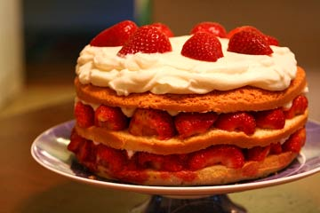
Strategies
Beliefs in Action
How do you bake a cake?
Some strategies are more effective than others.
Piaget’s levels: Sensorimotor, Preoperational, Concrete Operational, Formal Operational, Transrational
TOTE (Test, Operate, Test, Exit)
Interrupt the strategy
Change the Test to start, add or delete an Operation

Slide 16
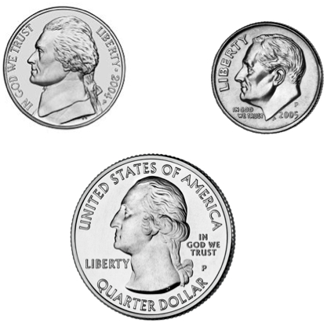
A Quick Quiz

Slide 17
Common Strategies
Metaprograms: Relatively Consistent Behaviors
Action—Initiate or Respond
Direction—Toward or Away-From
Source—Internal or External
Conduct—Rule Follower or Breaker
Response—Match or Mismatch
Scope—Global or Specific
Attention—Self or Other
Cognitive Style—Thinker or Feeler
Conformation—Visual, Auditory, or Kinesthetic and Number of Times or Frequency

Slide 18
Environment
Simple Deletion
I’m so angry.
I have a pain.
My spouse hurt me.
I’m depressed.
Statements of the Obvious
I’m still smoking.
This is my third appointment with you.
Stimulus-Response Conditioning
I faint when I get a shot.
White coats give me high blood pressure….

Slide 19
Useful Tools
Questions
What do you mean?
I’m wondering what you mean when you say…
I’m curious about your meaning…
How do you know?
What leads you to believe that?
What evidence have you seen that supports that?
Who (what, where, or how) exactly?

Slide 20
Uncovering and Changing Hidden Beliefs
Understanding Perceptual Frames
Reframing
Changing perspectives
Changing by degrees
Up the hierarchy, down the hierarchy, and out the door
Values
Beliefs
Strategies
Environment

Slide 21
Resources
Bowman and Basham. (2009). Healing with Language: Your Key to Effective Mind-Body Communication.
Elgin, Suzette. (1980). The Gentle Art of Verbal Self-Defense.
Katie, Byron. (2002). Loving What Is: Four Questions That Can Change Your Life.
Ruiz, Don Miguel. (1997). The Four Agreements: A Practical Guide to Personal Freedom.
Center for Nonviolent Communication: http://www.cnvc.org/

